Slide 1


Git Convention Guide Fresher training

Slide 2
Development workflow
The developer should checkout a new branch from develop branch and name the branch as convention:
If ticket is a feature: feature/TICKET-ID-branch_short_desc
If ticket is a bugfix: bugfix/TICKET-ID-branch_short_desc
If ticket is a hotfix: hotfix/TICKET-ID-branch_short_desc
Sample: feature/CENT-110-create_new_artist_screen

Slide 3
Development workflow (cont.)
The developer continue to work on this branch and every commit message should follow convention and avoid meaningless message:
[TICKET-ID] short message of this commit
Sample: [CENT-110] Fixed layout in artist screen Sample: [CENT-110] Added unit tests for artist API Avoid: [CENT-110] Fixed bug

Slide 4
Development workflow (cont.)
After finishing the ticket, the developer should run unit tests, check style on local.
The developer must do rebase before creating Pull Request (PR).
The developer goes to Bitbucket and create PR and follow convention:
PR Title: TICKET-ID: Short description of PR
PR Description: List of changes in this PR and checklist if needed
Add reviewers that will review the PR
The developer goes to Backlog, update Stage status to REVIEW and assign to a team member to review his/her PR

Slide 5
Development workflow (cont.)
The reviewer must do review after receiving request to review PR:
If the PR seems to be not good, add comments
If the PR looks good, approve PR and go to Backlog, update Stage status to MERGE
The developer should merge the PR and update Stage to TESTING and assign to the tester.
After the tester finish testing a feature, should update Stage to READY TO DEPLOY and update Status to RESOLVED
The Release Master will do release every week or 2 weeks (depends on sprint) and update Stage to PRODUCT CHECK
The tester will test against versus staging/production environment and confirm the feature/the bug has been done, then update Status to CLOSED

Slide 6
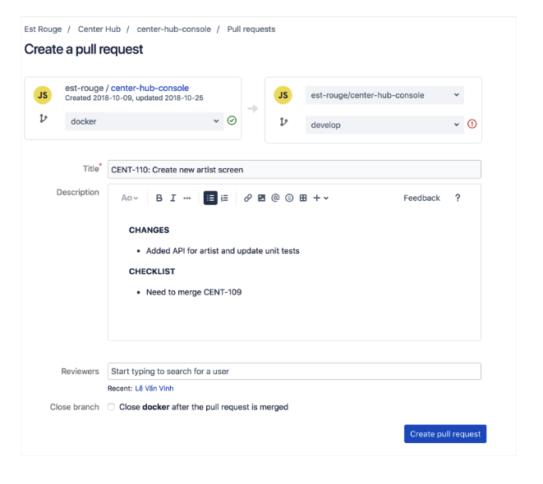
Development workflow (cont.)

Slide 7
Rebase vs. Merge
Merge option
Will create a new commit that ties together the histories of both branches.
The branch will have extraneous merge commit every time you need to incorporate changes
It can make it hard for other developers to understand the history of the project
Rebase option
Will moves the entire branch to begin on the tip of the base branch
Major benefit of rebasing is that you get a much cleaner project history.

Slide 8
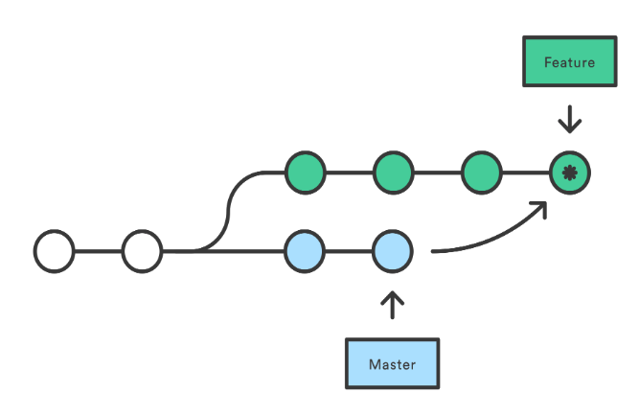
Rebase vs. Merge
Merge option

Slide 9
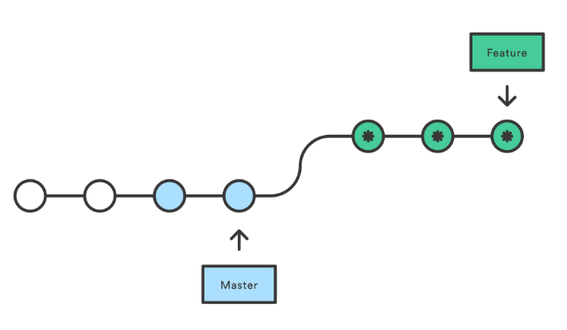
Rebase vs. Merge
Rebase option

Slide 10
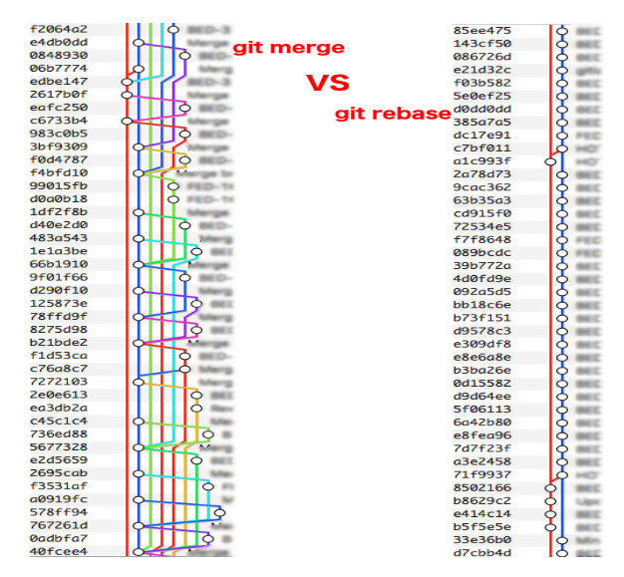
Rebase vs. Merge

Slide 11
How to rebase
Fetch new changes from remote: git fetch
Switch to branch develop: git checkout develop
Rebase branch develop to make sure local branch to be updated: git rebase origin/develop
Switch to branch feature: git checkout feature
Rebase branch feature on branch develop: git rebase develop

Slide 12

THANK YOU
Notes:
Ảnh công ty

